Slide 1

8.Food Safety: How can blockchain ensure the safety of food products by tracing their origins and quality?
Kaninika Datta
CSE(AIML)
12020002016054(42)

Slide 2
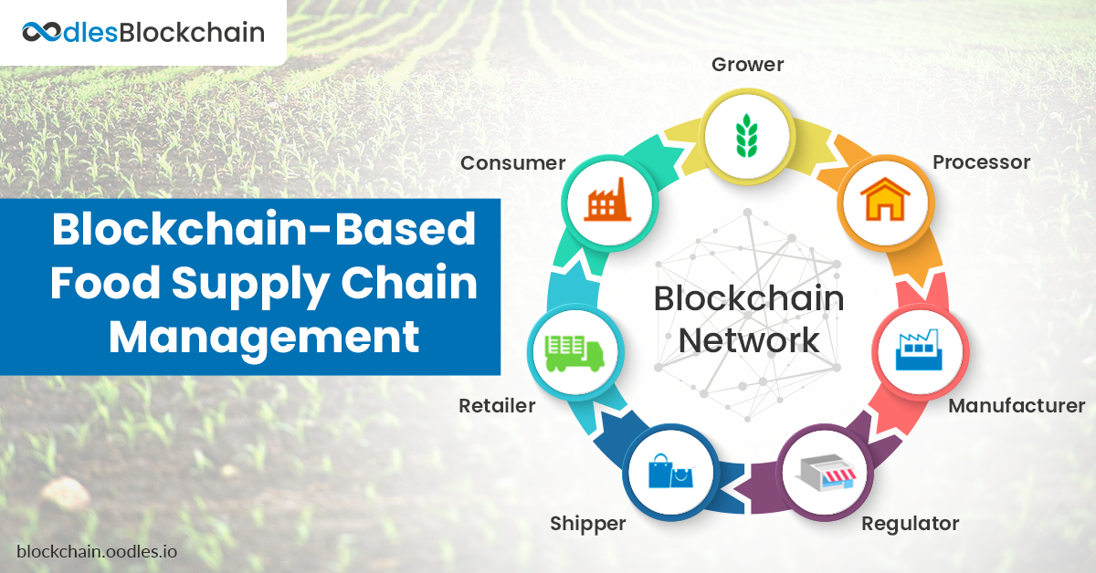

Slide 3
TABLE OF CONTENTS
01
02
03
04
Food safety
Benefits of Blockchain
Food origins and quality
In food industry
Real-World Applications
Challenges

Slide 4

01
FOOD SAFETY
Ensuring food integrity is essential to prevent foodborne diseases.

Slide 5
Introduction
Importance of food safety
Protection of Public Health
Prevention of Foodborne Diseases
Consumer Confidence
Legal and Regulatory Compliance
Long-Term Sustainability
Innovation and Research
Economic Impact
Challenges in Ensuring Food Safety
Globalization of the Food Supply Chain
Emerging Foodborne Pathogens
Supply Chain Complexity
Regulatory Compliance
Climate Change and Environmental Factors
Food Fraud and Counterfeiting
Crisis Management

Slide 6
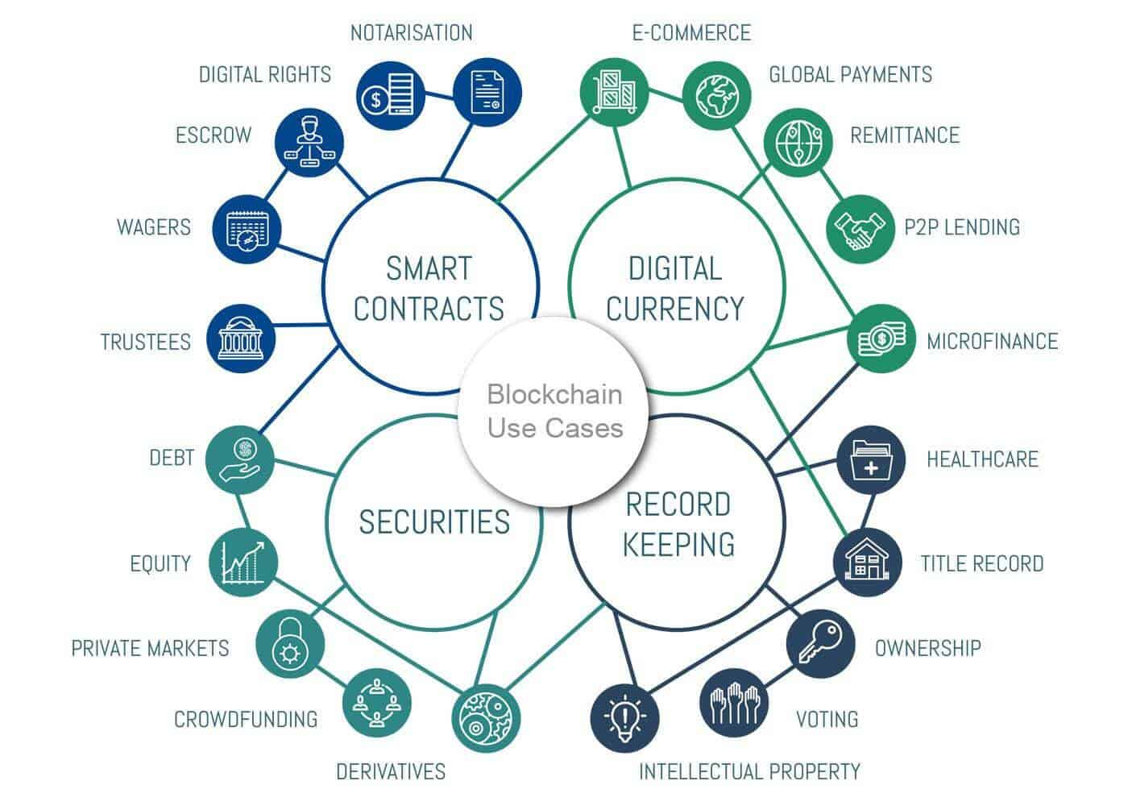
Blockchain Technology Basics
Blockchain is a decentralized and distributed digital ledger technology that records transactions across multiple computers or nodes in a way that ensures transparency, security, and immutability. It was originally developed as the underlying technology for cryptocurrencies like Bitcoin but has since found applications in various industries beyond finance.
This Photo by Unknown Author is licensed under CC BY-SA-NC

Slide 7
How blockchain works?
Decentralization
Cryptography
Instead of relying on a central authority, blockchain operates on a decentralized network of computers (nodes). Each node has a copy of the entire blockchain, and there is no single point of control.
Transactions are linked together in a chain using cryptographic hashes. This ensures the privacy and integrity of the data.
Transactions
Transactions are grouped together into blocks. These transactions can represent various types of data, not just financial transactions.

Slide 8


Immutability
Transparency
Once a block is added to the blockchain, it becomes extremely difficult to alter or delete the data within it. This immutability is achieved through the use of cryptographic hashes and the distributed nature of the network.
The entire transaction history is visible to all participants on the network. This transparency helps prevent fraud and ensures that all parties can trust the information recorded on the blockchain..
Smart Contracts
Consensus Mechanism
Some blockchain platforms, like Ethereum, support the creation and execution of smart contracts. These are self-executing contracts with the terms of the agreement directly written into code. They automatically execute when predefined conditions are met.
Before a new block is added to the blockchain, the network must reach a consensus to validate the transactions in that block. Different blockchain networks use different consensus mechanisms, such as Proof of Work (used in Bitcoin) or Proof of Stake.

Slide 9

BENEFITS OF BLOCKCHAIN IN FOOD SAFETY
02

Slide 10
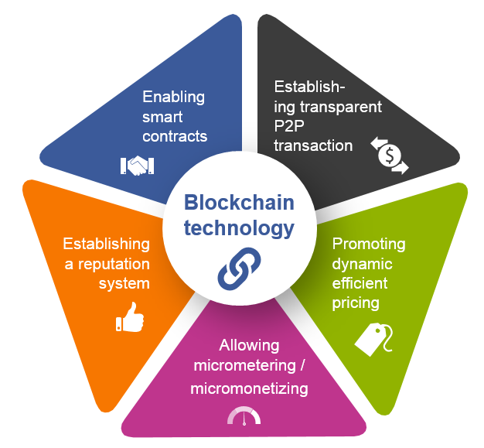
Prevention of Fraud
Enhanced Traceability
Improved Quality Control
Streamlined Supply Chain
Regulatory Compliance

Slide 11

03
REAL WORLD APPLICATIONS

Slide 12
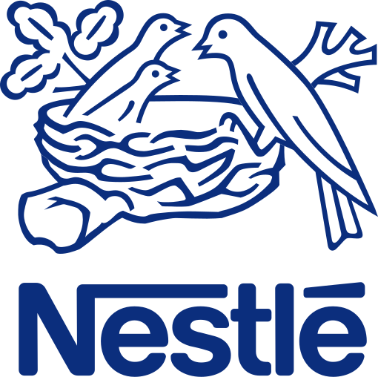

Companies using Blockchain
Walmart and IBM partner to maintain the retailer’s Food Traceability Initiative, created in 2018. For the initiative, Walmart uses the Hyperledger Fabric blockchain platform, which lets officials trace the lifespan of their products to ensure food safety and reduce waste. The initial ledger experiments found promising benefits, most notably the ability to track the origin of U.S. perishables, such as mangoes, within 2.2 seconds.
Since 2017, Nestlé has utilized the IBM Food Trust blockchain ledger to help users trace the origin of products like its Mousline purée and Zoégas coffee brands. In collaboration with the Rainforest Alliance, Nestlé is able to track farmer and harvest information for cocoa beans used in Zoégas coffee, all to provide transparency for consumers plus increase sustainability for farmers and natural resources.

Slide 13
04
CHALLENGES

Slide 14
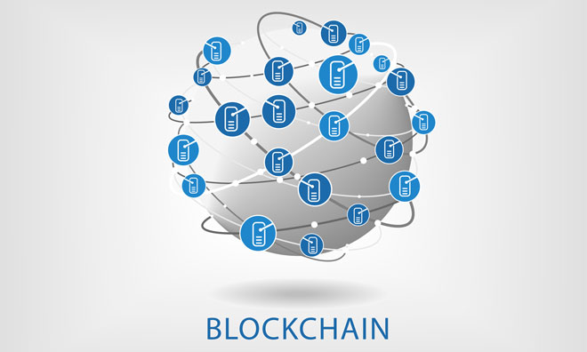
Issues and Considerations
Adoption Challenges
Data Accuracy Concerns
Interoperability Issues
Privacy and Security Considerations

Slide 15
Conclusion
Food safety is a critical concern for both consumers and the industry due to its impact on public health, economics, and brand reputation.
Blockchain technology offers a powerful solution for enhancing food safety by providing secure, transparent, and immutable traceability of food products.
We discussed how blockchain works in food traceability, its benefits, including enhanced traceability, improved quality control, fraud prevention, and streamlined supply chains.
We also addressed the challenges and considerations, such as adoption, interoperability, data accuracy, and privacy concerns.

Slide 16
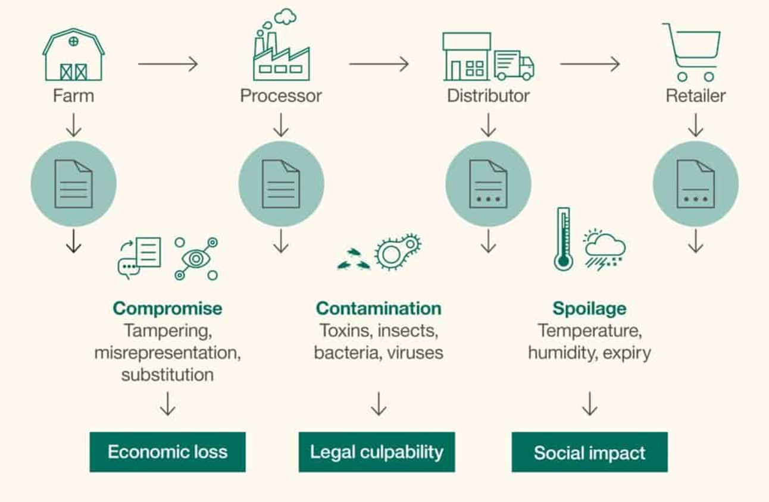
Blockchain in the food supply chain

